Slide 1


FROGGER! (on Spartan 3-E Dev. Board)
ECE 525.442 VHDL Microprocessor Design
Final Student Project
August 14th, 2012
Emily Kan
Erik Lee
Edward Jones

Slide 2
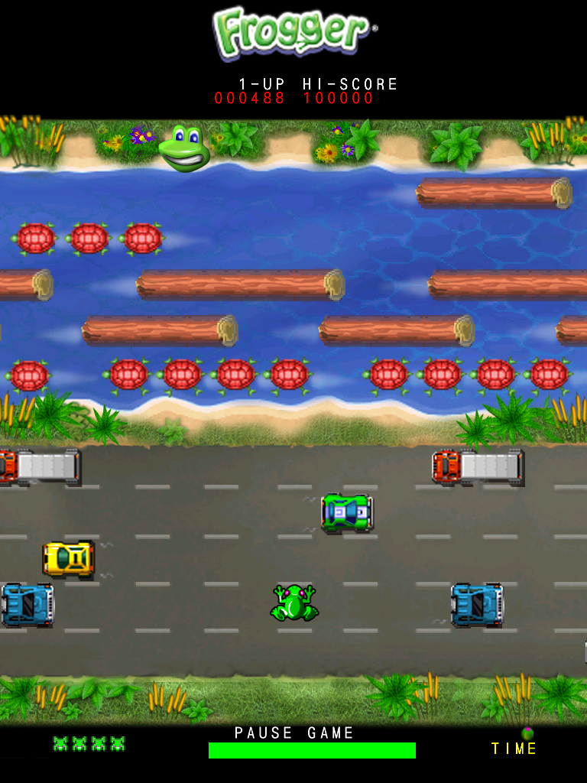
Outline
Introduction
Background
Design
Implementation/ Verification
Troubleshooting
Results & Analysis
Conclusion
Future Outlook
References
*Note: Not our version implemented in this project!

Slide 3
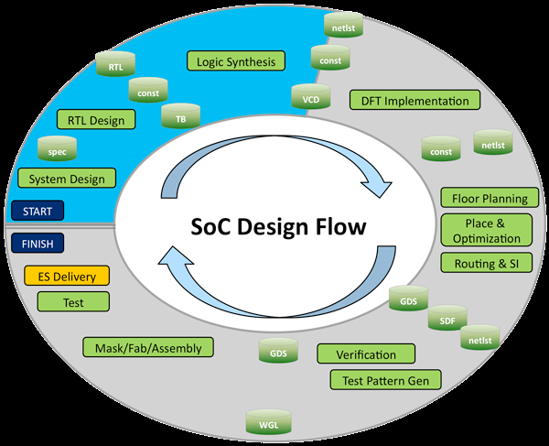
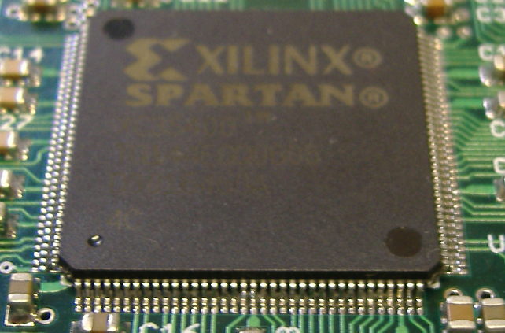
Introduction
Low-cost / scalable design influence increases with advances in modern technology
Design reusability becoming more prominent in marketplace
Digital Design w/FPGAs begins to grow
Core IP VHDL files easily adaptable and reusable with existing FPGAs
Multiple VHDL core instantiations leads to improved design flow

Slide 4

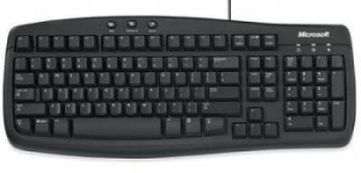
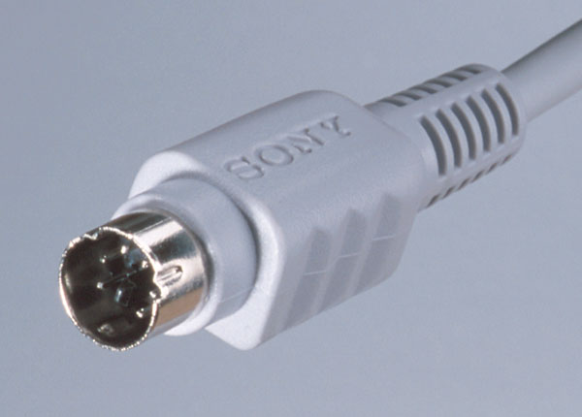
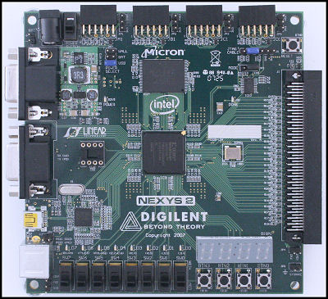
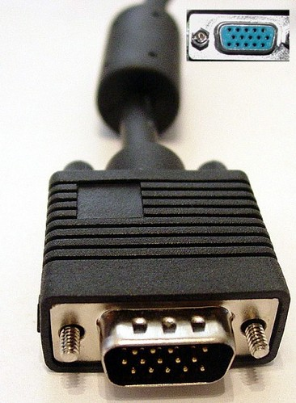
Introduction cont’d
Video game development becomes easier!
Functionality of video games application is moved from circuit board ICs to FPGA
Alleviates some design challenges, leaving designers to create the implementation
Keyboard use
Port Control
Display output
FPGA selection

Slide 5
Background
Flow of game design
Start-Up Sequence
Initialize VGA Controller
Create initial Background Display
Generate Moving Objects
Game Sequence
Create Frog at Reset Position
Detect Frog Motion
Check Frog position against objects
Output Score

Slide 6
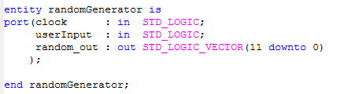
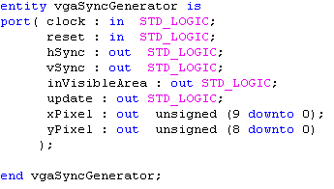
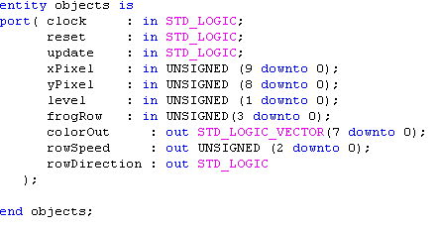
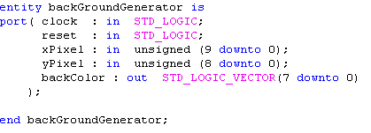
Design
Four files for initial Start-Up Sequence
(1) vgaSyncGenerator.vhd
(2) backGroundGenerator.vhd
(3) Objects.vhd
(4) randomGenerator.vhd
Entity definitions for VHDL files

Slide 7
Design cont’d
vgaSyncGenerator.vhd
Creates Horizontal & Vertical display using pixel counters: Hsync / Vsync driven by a 25 MHz clock generated from FPGA
Color output created by 8-bit colors generated on VGA port
640
Control Module
VGA Port
H-sync
V-sync
Red (3-bit)
Green (3-bit)
Blue (2-bit)
Output Resolution
480

Slide 8
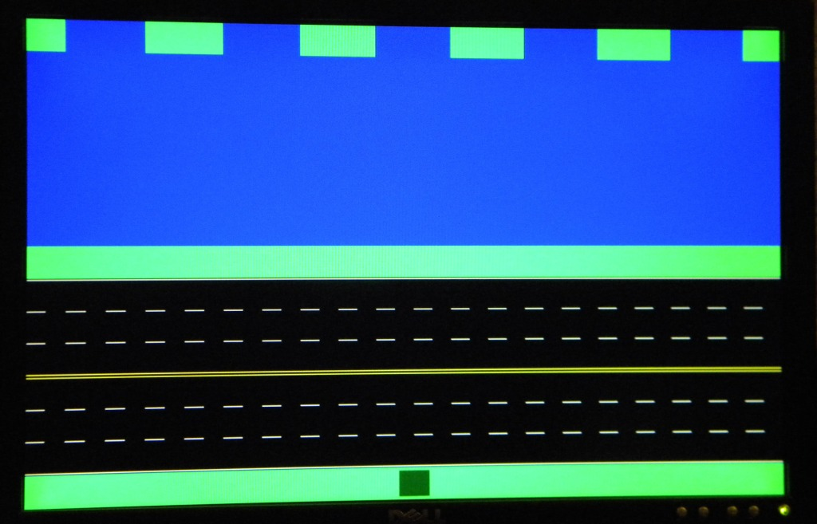
Design cont’d
backGroundGenerator.vhd
Creates the initial background image as a “map” for the game
Colors created from horizontal and vertical counting vector position from VGA driver signals
Upper Half depicts “water” zone
Lower Half depicts “street” zone
Grass area always “safe”

Slide 9
Design cont’d
backGroundGenerator.vhd
Creates the initial background image as a “map” for the game
Colors created from horizontal and vertical counting vector position from VGA driver signals
Upper Half depicts “water” zone
Lower Half depicts “street” zone
Grass area always “safe”

Slide 10
Design cont’d
randomGenerator.vhd
Implements a random stream of bits
Implements a 12 bit Linear Feedback Shift Register ( Taps: 12, 6, 4, 1 )
Independent reset
Also includes an input from the user to make numbers more random
Length, color, and jump are influenced by the random generator

Slide 11
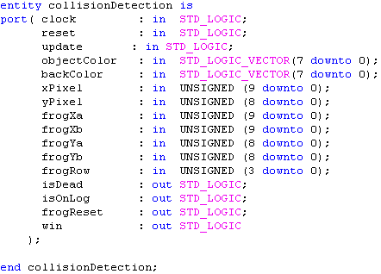
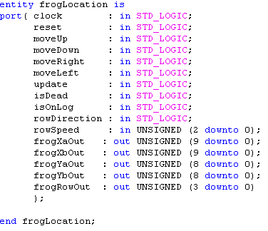
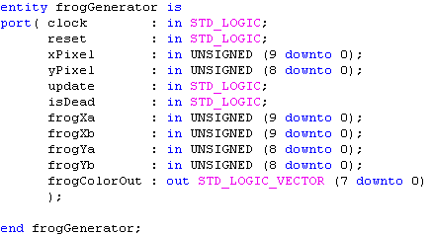
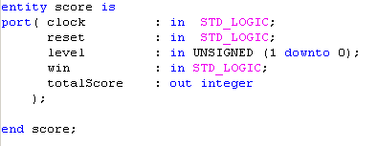
Design cont’d
Four files for Game Sequence
(1) frogGenerator.vhd
(2) frogLocation.vhd
(3) collisionDetection.vhd
(4) score.vhd
Entity definitions for VHDL files

Slide 12
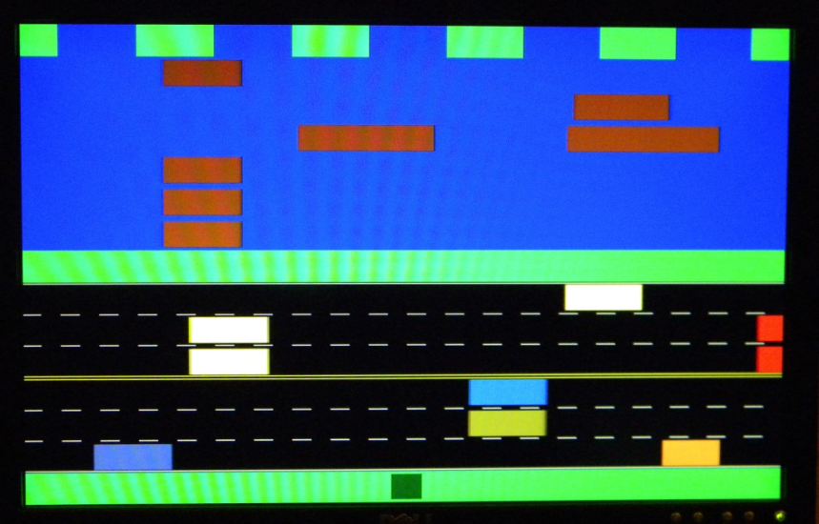
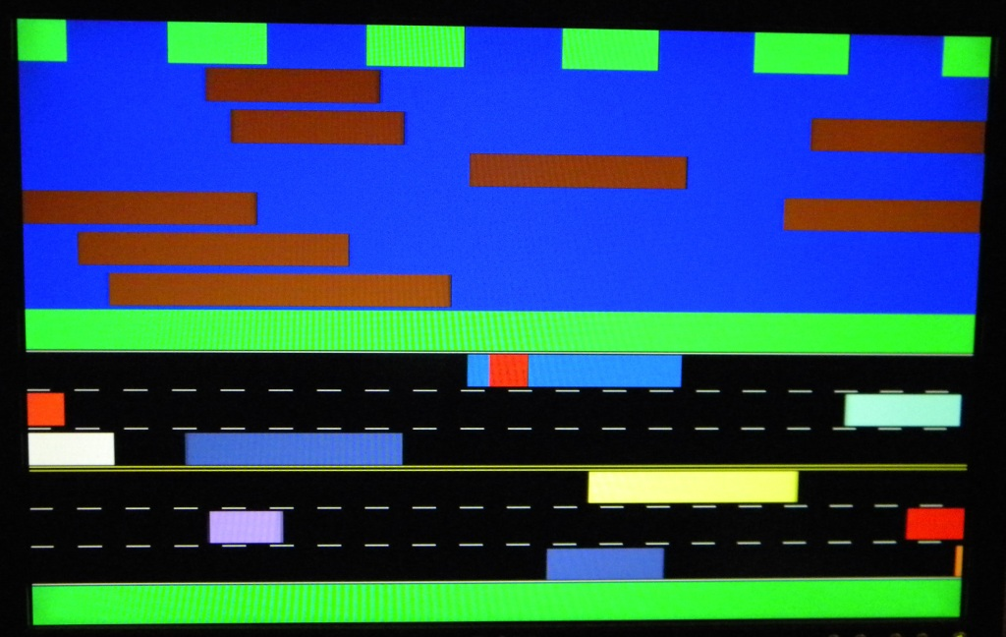
Design cont’d
frogGenerator.vhd
Generates a square block dubbed as the “frog” to traverse through generated course
Implements “dead frog” flashing code if frog moves into hazardous play field
Dead Frog Flashing
Normal Frog Color

Slide 13
Design cont’d
frogLocation.vhd
As the frog moves up the screen, row position & column position vs. objects is being tracked for collision detection
Column Position (640 Pixels)
Row position
(15 blocks)

Slide 14
Design cont’d
collisionDetection.vhd
Mealy State machine
Places frog “block” in action state
Five states as frog travels through game map
On Road
On Grass
On River
Dead
Win
State changes depending on object and background colors

Slide 15
Design cont’d
collisionDetection.vhd cont’d…
All
Bgcolor=green
Dead=‘0’
All Bgcolor=black
Dead=‘0’
Any Objcolor /= black
Dead =‘0’
On Road
Any Bgcolor = black
Dead=‘0’
All Bgcolor=green/
Dead=‘0’
On Grass
Dead
Counter >=3secs
Dead=‘0’
Reset=‘1’
All Bgcolor=blue
Dead=‘0’
All objcolor = black
Dead = ‘0’
Counter>=3secs/
Reset=‘1’, Win=‘1’
Any objcolor = green Row = 0
Dead=‘0’
Counter< 3secs
Dead=‘1’
Win
On River
Any objcolor = brown/
OnLog =‘1’
Counter< 3secs
Dead=‘0’

Slide 16
Design cont’d
Score.vhd
Point value of 10, 20, or 50 points depending on level of difficulty
Difficulty set by user (3 settings)
Max of 5000
Can only set at start position
Output of running total is displayed on seven segment display on Spartan 3E dev board

Slide 17
Design cont’d
Miscellaneous Components
Keyboard Component Instantiation
Core Implemented in design
Mapped to frog direction
Output clock to keyboard
Input Key Press data from keyboard
Map data to frog direction
De-bounce Circuit
Mapped to buttons on FPGA
for user input and switches for levels
Keyboard
Data
Clock
PS/2 Module
Data
Clock
Up | Down | Left | Right
Game Module

Slide 18
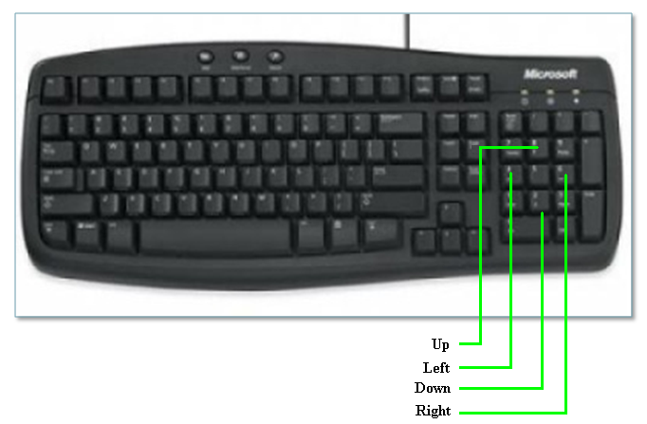
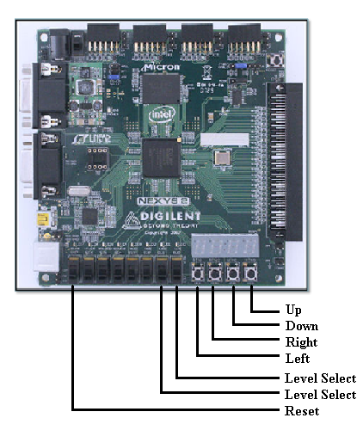
Design cont’d
User input to game
Choice of keyboard entry or development board

Slide 19
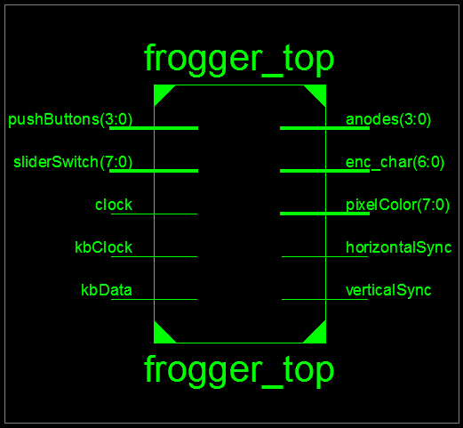

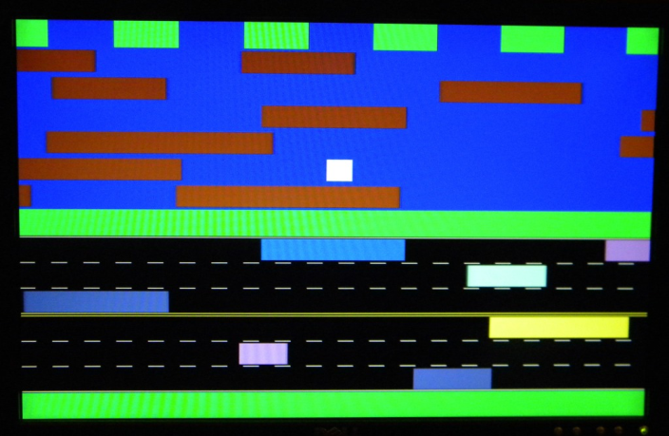
Implementation & Verification
Synthesized Top Module
15 inputs, 21 outputs
Troubleshooting
Object verification, death sequence

Slide 20
Results & Analysis
VGA drivers
2 Counters ( pixel count)
35 DFFs
2 Adders / Subtractors
8 Comparators
Frogger Keyboard driver
1 Counter
20 DFFs
1 XOR
Background Generator
8 DFFs
Object Generator
60 DFFs
7 Adder / Subtractor
9 Comparators
Random Generator
1 Counter
1 DFF
1 Comparator
1 Xor
Frog Generator
1 Counter
8 DFFs
5 Comparators
Frog Location
1 ROM (frog Row location)
42 DFFs
3 Adders / Subtractors
3 Comparators
1 Finite State Machine
5 states, 61 transitions, 22 inputs, 3 outputs
1 Counter
64 DFFs
8 Comparators
Score Keeper
1 ROM
38 DFFs
1 Adder/Subtractor
1 Comparator

Slide 21
Results & Analysis
7 Segment Driver
1 ROM
1 Counter
34 Adders / Subtractors
34 Comparators
4 Multiplexers
LED Decoder
1 ROM
Top Level Frogger
1 Counter
9 DFFs
1 Comparator

Slide 22
Results & Analysis cont’d
FPGA Resource Utilization
HDL Resource Synthesis Report
ROMs | 4
Adders/Subtractors | 124
Counters | 16
Accumulators | 48
Registers | 533
Comparators | 178
Multiplexors | 1
FSMs | 1
XORs | 57
Flip Flops | 1163
Inputs | 15
Outputs | 21

Slide 23
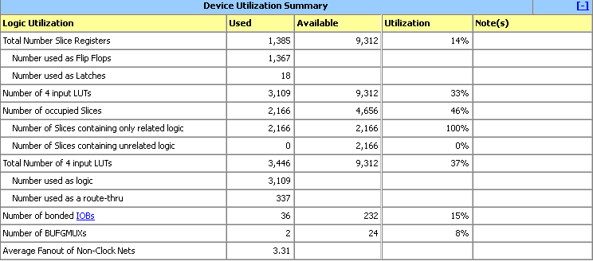
Results & Analysis cont’d
FPGA Device Utilization

Slide 24
Conclusion
Frogger game provided in-depth experience into all phases of design and development using Xilinx FPGA tools:
Multiple Component Instantiation
Multi-file Design Integration
I/O Port configuration
Spartan 3E development board package provides robust environment for video game creation:
Map drawing and level selection
Character direction and event driven outcomes
Score computation

Slide 25
Conclusion cont’d
Future Outlook / Development
Development of frog and background objects using image files pre-loaded into SRAM
Reduction of device utilization
Use block or distributed RAM
Reduce number of DFFs
Use an embedded processor to reduce the duplicated logic
Add levels of complexity
Additional frog lives
“Win” screen
Sound effects

Slide 26
References
NEXYS2 Reference Manual
FPGA Resource Guide http://www.digilentinc.com/showcase/contests/designcontest.cfm?contestid=8
Keyboard Implementation & Application http://www.pyroelectro.com/tutorials/ps2_keyboard_interface/theory_ps2.html

